Slide 1

Wireless Power Transfer
C1C Henry
C1C Hermanson
C1C Pak
C1C Singh
1

Slide 2
Overview
Technical Discussion/Attack Vector Review - NSTR
Motivation - NSTR
Problem Statement - NSTR
Key Sprint Accomplishments
Results
Challenges
Sprint 8
Future Work - NSTR
Questions

Slide 3
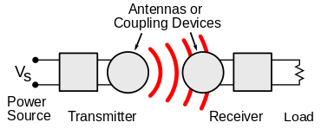
Technical Discussion
WPT is wireless point to point transmission protocol of electrical energy
Many implementations but Qi is the industry standard
  Alternatives: AirFuel, Proprietary Near Field Magnetic Coupling, RF, Ultrasound
Delivers a variable amount of voltage to device depending on power requirements
New technology that lacks security capabilities and has vulnerabilities
  Malicious messages can be sent between transmitter and receiver to alter power transmission
  Messages between transmitter and receiver can be observed to gain information about receiver

Slide 4
Motivation
Wireless Power Transfer has become an industry standard being incorporated into more and more areas of technology
  Personal Electronics, Healthcare Devices, Electric Vehicles
Exploit techniques and results found in this experiment can potentially be generalized
This research will create a foundation for further experimentation and TTP development
  Findings expanded to other wireless non-networked point-to-point connections

Slide 5
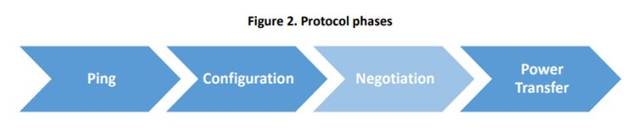
Qi Specs
AC frequency in the primary coil
  110 and 205 kHz for the “low power” Qi chargers (up to 5 W)
  80 and 300 kHz (up to 120 W) for the “medium power” chargers
Optimized to operate from a 5V USB power supply
  Uses “smart power limiting” to adjust the output power automatically to compensate for power-limited supplies

Slide 6
Motivation
Wireless Power Transfer has become an industry standard being incorporated into more and more areas of technology
  Personal Electronics, Healthcare Devices, Electric Vehicles
Exploit techniques and results found in this experiment can potentially be generalized
This research will create a foundation for further experimentation and TTP development
  Findings expanded to other wireless non-networked point-to-point connections

Slide 7
Problem Statement
IDENTIFY
  Vulnerabilities
  How to exploit
  How to defend
APPLY
  Proof of concept – hijacking
  Proof of concept – eavesdropping
  Interpretation of results
EXPAND
  Provide research to NRO
  Observe various side channel-attacks
  Create security mitigations – Software Based Encryption
  Expand to larger technologies

Slide 8
Key Sprint Accomplishments
Injection Via Waveform Generator
Scripted Packet Generation
Encryption Simulink Visualization
CSURF Preparation
Research Paper

Slide 9
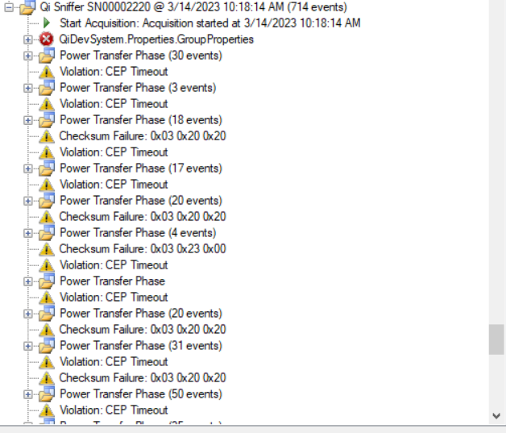
Injection Via Waveform Generator
Utilizes csv files to inject crafted signals
Capture interactions via qi sniffer
Demonstrated greater overlap with signal injection
Existing Challenge
  timing and overlapping of signal messages
  Outright injection vs message overlap

Slide 10
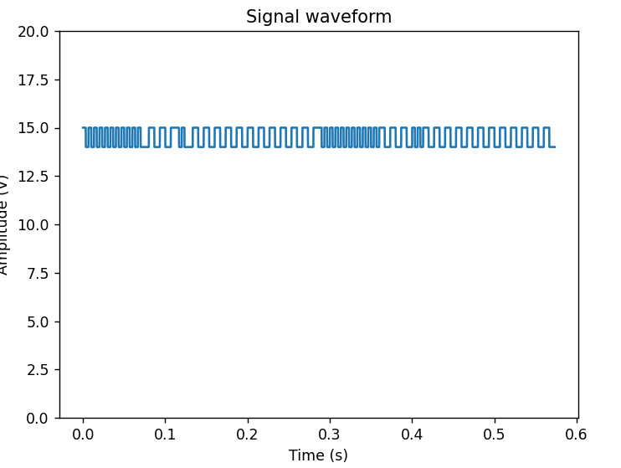
Scripted Packet Generation
Generates Qi Signal – Exported via output csv file
Converts binary data into modulated signal utilizing a user specified sampling rate and clock frequency
Two types of Packets
  End Power Transfer (EPT) Control 1
  Control Error (CE) Control 1
Stages
  Preamble (Between 11 and 25 bits)
  Header
  Data Message
  Checksum

Slide 11
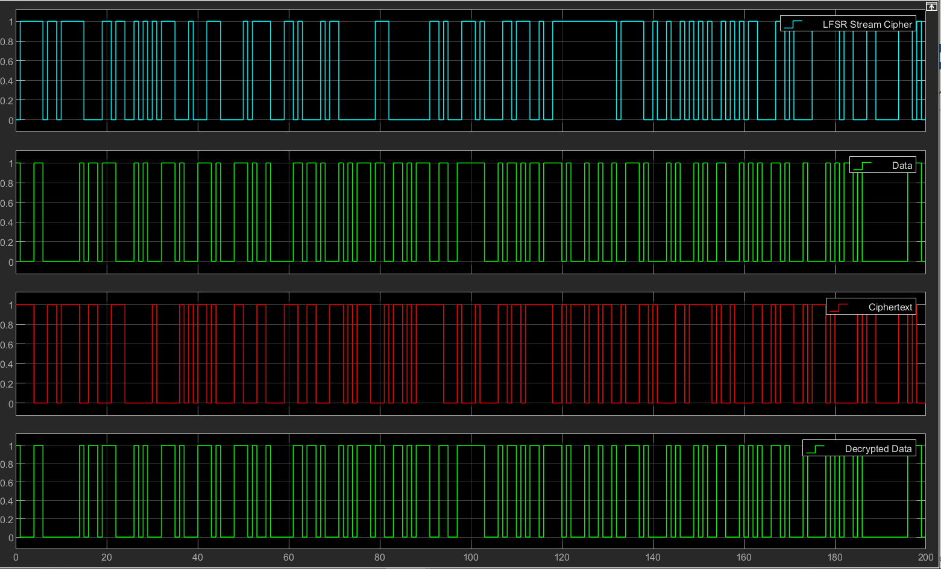
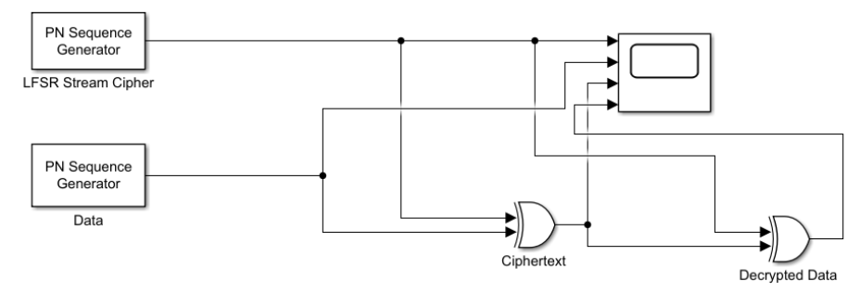
Encryption Simulink Visualization
LFSR
  Proof of concept
  Input: stream cipher, message bits
    Simple XOR
  Output: Ciphertext

Slide 12
CSURF Preparation
Poster and abstract completed and approved
Registration approved

Slide 13
Research Paper
Began writing research paper as a culminating artifact for the capstone
Paper will focus on three main areas
  Injection
  Signature Analysis
  Encryption
Formatting via Overleaf
Primary Focus of Sprint 8

Slide 14
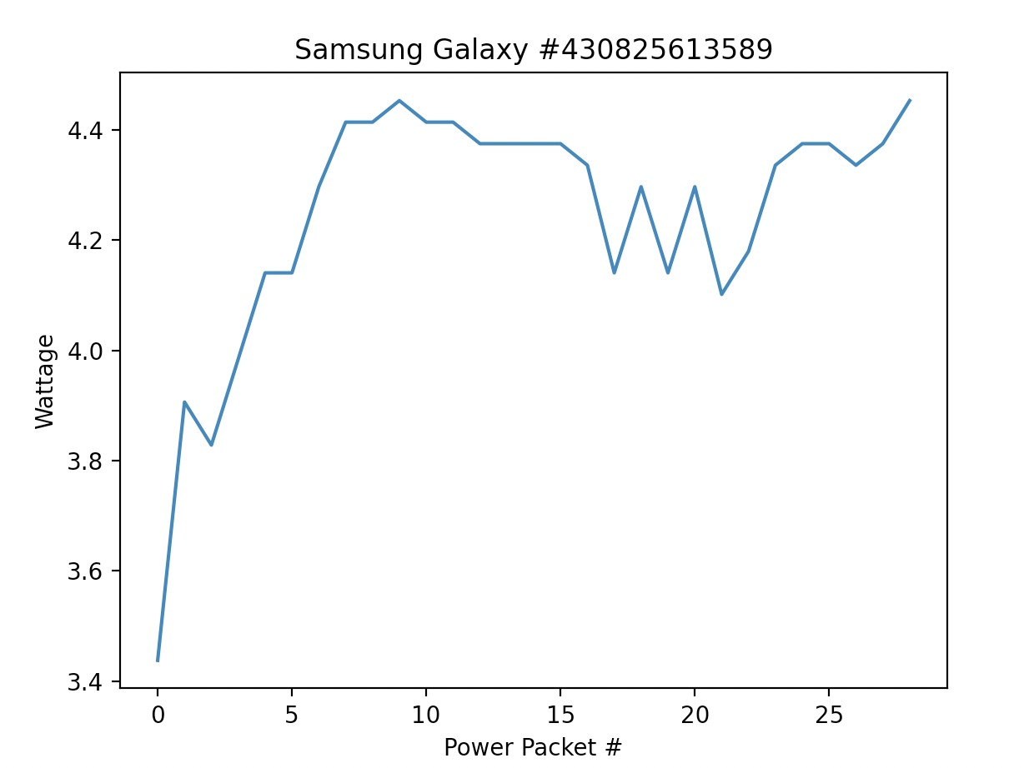
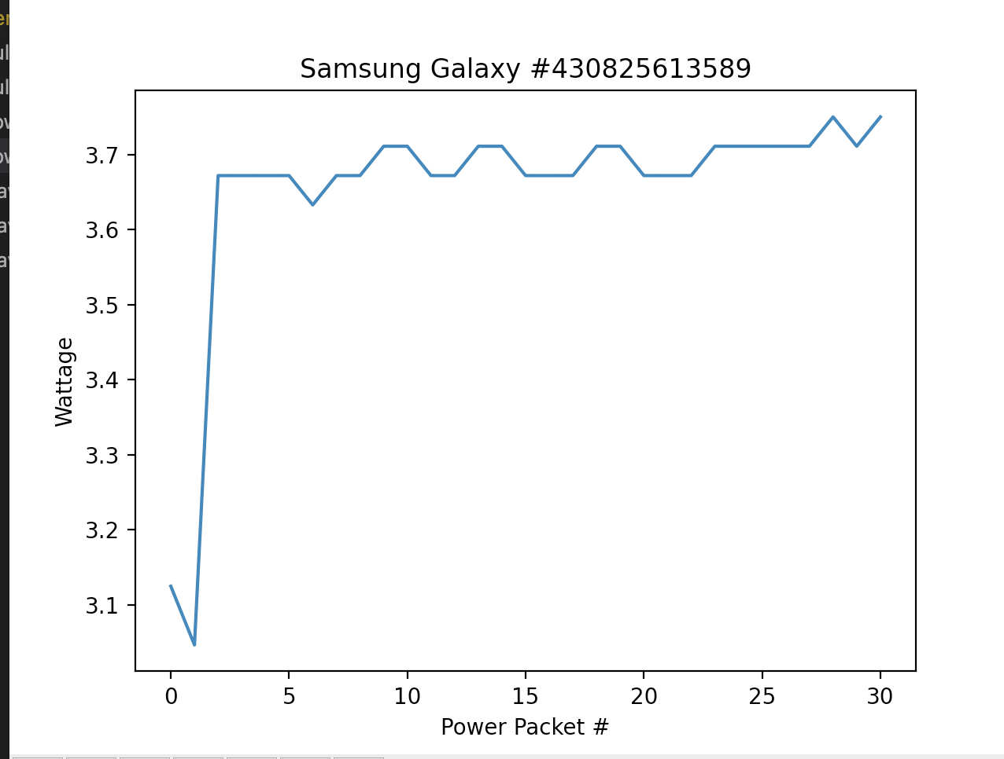
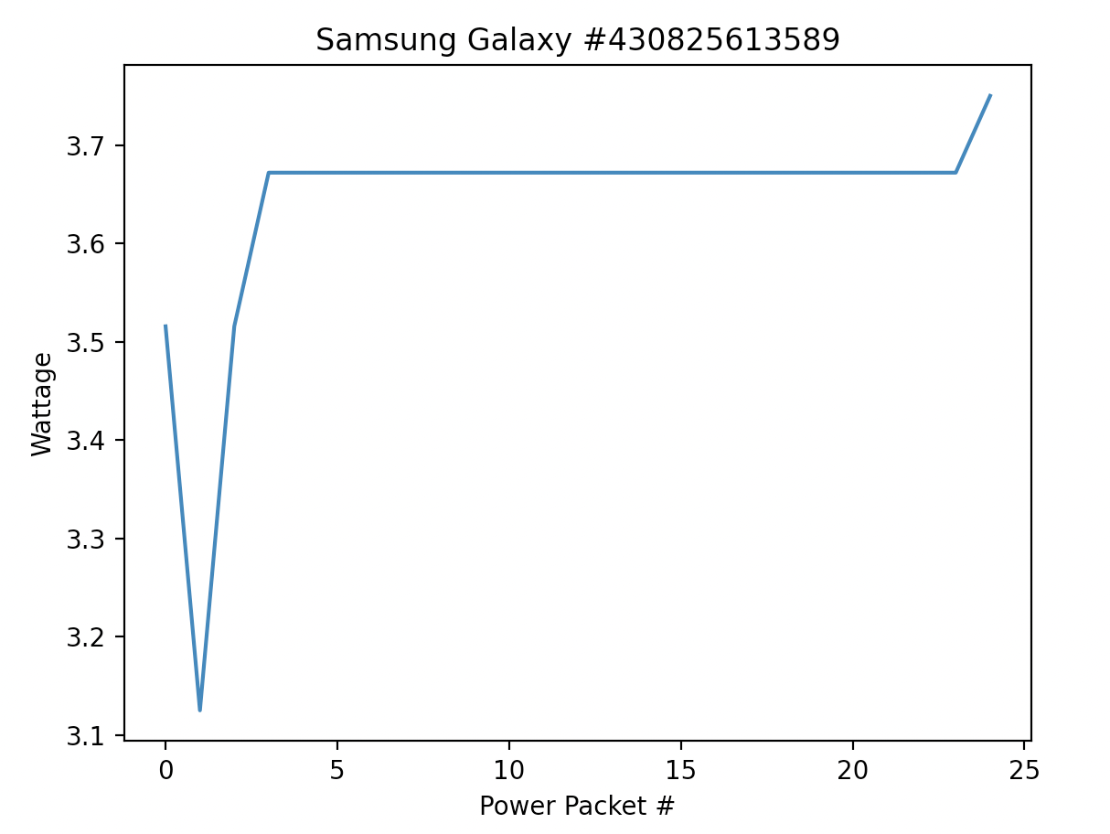
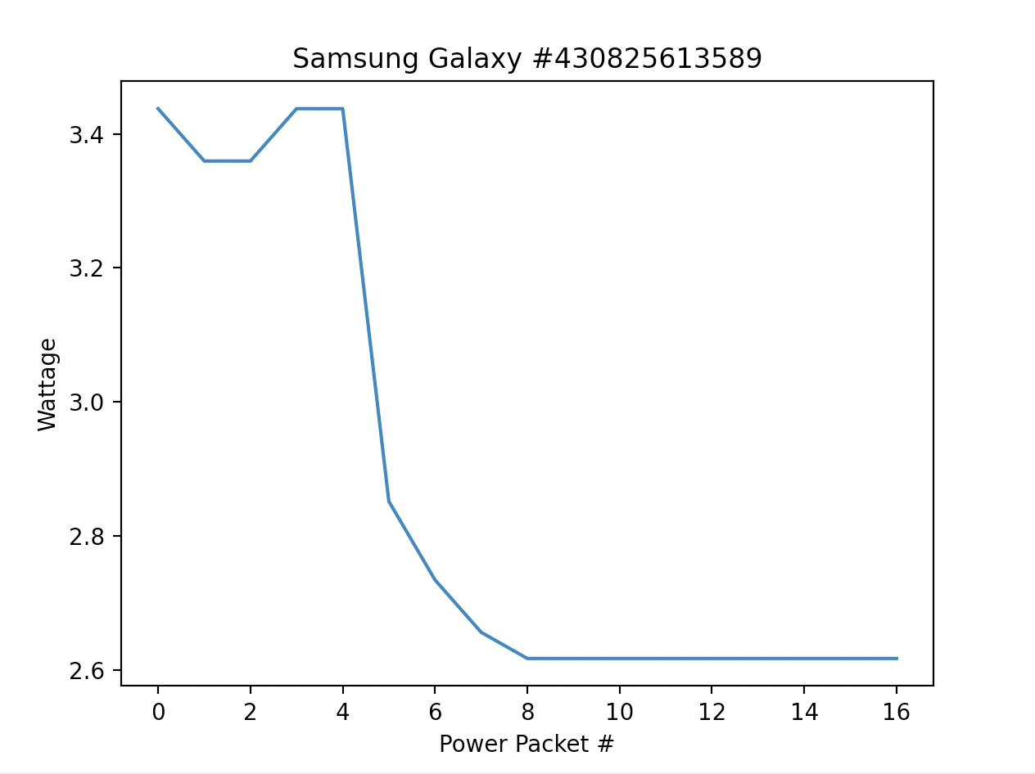
Signature Analysis
  Results match research
  Less intensive software requires less power and is less volatile
Low Power Youtube
High Power Youtube
Low Power Lock Screen
Low Power Lock Screen

Slide 15
Discussion of Progress and Implications
Based on research and testing findings, Qi is an unsecure standard
  It is susceptible to multiple attack vectors (based on proof of concept)
  It is open air and thus susceptible to snooping (based on proof of concept)
There are some available methods to attempt to alleviate these vulnerabilities
  Encryption (working towards proof of concept)
Other technologies/standards could be susceptible in the same ways
  AirFuel, Proprietary Near Field Magnetic Coupling, RF, Ultrasound, EV Charging, Medical devices

Slide 16
Sprint 8 – Taskers/COA
Focus on completion of Research Paper
  Inclusion of all relevant areas study and data/images to support
  Formatting and citations as needed
Packet Snooping and Injection Mitigations
  Likely an expansion of existing encryption findings

Slide 17
Future Work
Modification of Qi packets
  Qi communication packets are interpreted on the receiver device, modification of the data component within the Negotiation Phase may allow code execution or data exfiltration on the receiver device
Development and testing of Qi Protection Mechanisms
  Hardware or Software based cryptography
  Injection/packet modification detection
Applications with laser-based point-to-point communication
  Non-networked systems

Slide 18
Questions?

